Slide 1
Turing Machines

Slide 2
Agenda
Turing Machines
Alan Turing
What is TM and How it Works?
Definitions
Computation
TM Configuration

Slide 3
Alan Turing
Alan Turing was one of the founding fathers of CS.
His computer model –the Turing Machine– was inspiration/premonition of the electronic computer that came two decades later
Invented the “Turing Test” used in AI
Legacy: The Turing Award. Pre-eminent award in Theoretical CS

Slide 4
A Thinking Machine
First Goal of Turing’s Machine: A model that can compute anything that a human can compute. Before invention of electronic computers the term “computer” actually referred to a person who’s line of work is to calculate numerical quantities!
Turing’s Thesis: Any “algorithm” can be carried out by one of his machines
Notes:
If you want to include the logician Alonzo Church in the computability party, instead of Turing’s Thesis, say Church-Turing Thesis. If you want to include Emil Post, say Church-Post-Turing Thesis.

Slide 5
A Thinking Machine
Second Goal of Turing’s Machine: A model that’s so simple, that can actually prove interesting epistemological results
Turing’s machine is easily programmable.

Slide 6
A Thinking Machine
Imagine a super-organized, obsessive-compulsive human computer. The computer wants to avoid mistakes so everything written down is completely specified one letter/number at a time. The computer follows a finite set of rules which are referred to every time another symbol is written down. Rules are such that at any given time, only one rule is active so no ambiguity can arise. Each rule activates another rule depending on what letter/number is currently read, EG:

Slide 7
A Thinking Machine EG Successor Program
Sample Rules:
If read 1, write 0, go right, repeat.
If read 0, write 1, HALT!
If read , write 1, HALT!
Let’s see how they are carried out on a piece of paper that contains the reverse binary representation of 47:
Notes:
“” stands for reading a blank cell, in which nothing has been written.

Slide 8
A Thinking Machine EG Successor Program
If read 1, write 0, go right, repeat.
If read 0, write 1, HALT!
If read , write 1, HALT!
1 | 1 | 1 | 1 | 0 | 1

Slide 9
A Thinking Machine EG Successor Program
If read 1, write 0, go right, repeat.
If read 0, write 1, HALT!
If read , write 1, HALT!
0 | 1 | 1 | 1 | 0 | 1

Slide 10
A Thinking Machine EG Successor Program
If read 1, write 0, go right, repeat.
If read 0, write 1, HALT!
If read , write 1, HALT!
0 | 0 | 1 | 1 | 0 | 1

Slide 11
A Thinking Machine EG Successor Program
If read 1, write 0, go right, repeat.
If read 0, write 1, HALT!
If read , write 1, HALT!
0 | 0 | 0 | 1 | 0 | 1

Slide 12
A Thinking Machine EG Successor Program
If read 1, write 0, go right, repeat.
If read 0, write 1, HALT!
If read , write 1, HALT!
0 | 0 | 0 | 0 | 0 | 1

Slide 13
A Thinking Machine EG Successor Program
If read 1, write 0, go right, repeat.
If read 0, write 1, HALT!
If read , write 1, HALT!
0 | 0 | 0 | 0 | 1 | 1

Slide 14
A Thinking Machine EG Successor Program
So the successor’s output on 111101 was 000011 which is the reverse binary representation of 48.
Similarly, the successor of 127 should be 128:
Notes:
“” stands for reading a blank cell, in which nothing has been written.

Slide 15
A Thinking Machine EG Successor Program
If read 1, write 0, go right, repeat.
If read 0, write 1, HALT!
If read , write 1, HALT!
1 | 1 | 1 | 1 | 1 | 1 | 1

Slide 16
A Thinking Machine EG Successor Program
If read 1, write 0, go right, repeat.
If read 0, write 1, HALT!
If read , write 1, HALT!
0 | 1 | 1 | 1 | 1 | 1 | 1

Slide 17
A Thinking Machine EG Successor Program
If read 1, write 0, go right, repeat.
If read 0, write 1, HALT!
If read , write 1, HALT!
0 | 0 | 1 | 1 | 1 | 1 | 1

Slide 18
A Thinking Machine EG Successor Program
If read 1, write 0, go right, repeat.
If read 0, write 1, HALT!
If read , write 1, HALT!
0 | 0 | 0 | 1 | 1 | 1 | 1

Slide 19
A Thinking Machine EG Successor Program
If read 1, write 0, go right, repeat.
If read 0, write 1, HALT!
If read , write 1, HALT!
0 | 0 | 0 | 0 | 1 | 1 | 1

Slide 20
A Thinking Machine EG Successor Program
If read 1, write 0, go right, repeat.
If read 0, write 1, HALT!
If read , write 1, HALT!
0 | 0 | 0 | 0 | 0 | 1 | 1

Slide 21
A Thinking Machine EG Successor Program
If read 1, write 0, go right, repeat.
If read 0, write 1, HALT!
If read , write 1, HALT!
0 | 0 | 0 | 0 | 0 | 0 | 1

Slide 22
A Thinking Machine EG Successor Program
If read 1, write 0, go right, repeat.
If read 0, write 1, HALT!
If read , write 1, HALT!
0 | 0 | 0 | 0 | 0 | 0 | 0

Slide 23
A Thinking Machine EG Successor Program
If read 1, write 0, go right, repeat.
If read 0, write 1, HALT!
If read , write 1, HALT!
0 | 0 | 0 | 0 | 0 | 0 | 0 | 1

Slide 24
A Thinking Machine
It was hard for the ancients to believe that any algorithm could be carried out on such a device.
However, ancients did finally believe Turing contribution and great invention of his machine i.e. Turing Machine.

Slide 25
Turing Machines
A Turing Machine (TM) is a device with a finite amount of read-only “hard” memory (states), and an unbounded amount of read/write tape-memory. There is no separate input. Rather, the input is assumed to reside on the tape at the time when the TM starts running.
TM’s can either be input/output machines ,or yes/no decision machines.

Slide 26
Turing Machine Model
The Turing Machine can be thought of as a finite-state automaton connected to a Read/Write head.
It has one tape which is divided into a number of cells.
 |  | a1 | a2 | a3 |  |  |  | b | b | b
R/W Head
Tape divided into cells of infinite length
Finite-state automaton

Slide 27
Each cell store only one symbol.
The input and the output from the finite state automaton are effected by the R/W head, which can examine one cell at a time.
In one move the machine examines the present symbol under the R/W head on the tape and the present state of an automaton to determine:
a new symbol to be written on the tape in the cell under R/W head.
a motion of the R/W head along the tape; either head will move one cell L or R .
The next state of the automaton.
Whether to halt or not.

Slide 28
How it Works?
A Turing Machine - Overview.mp4

Slide 29
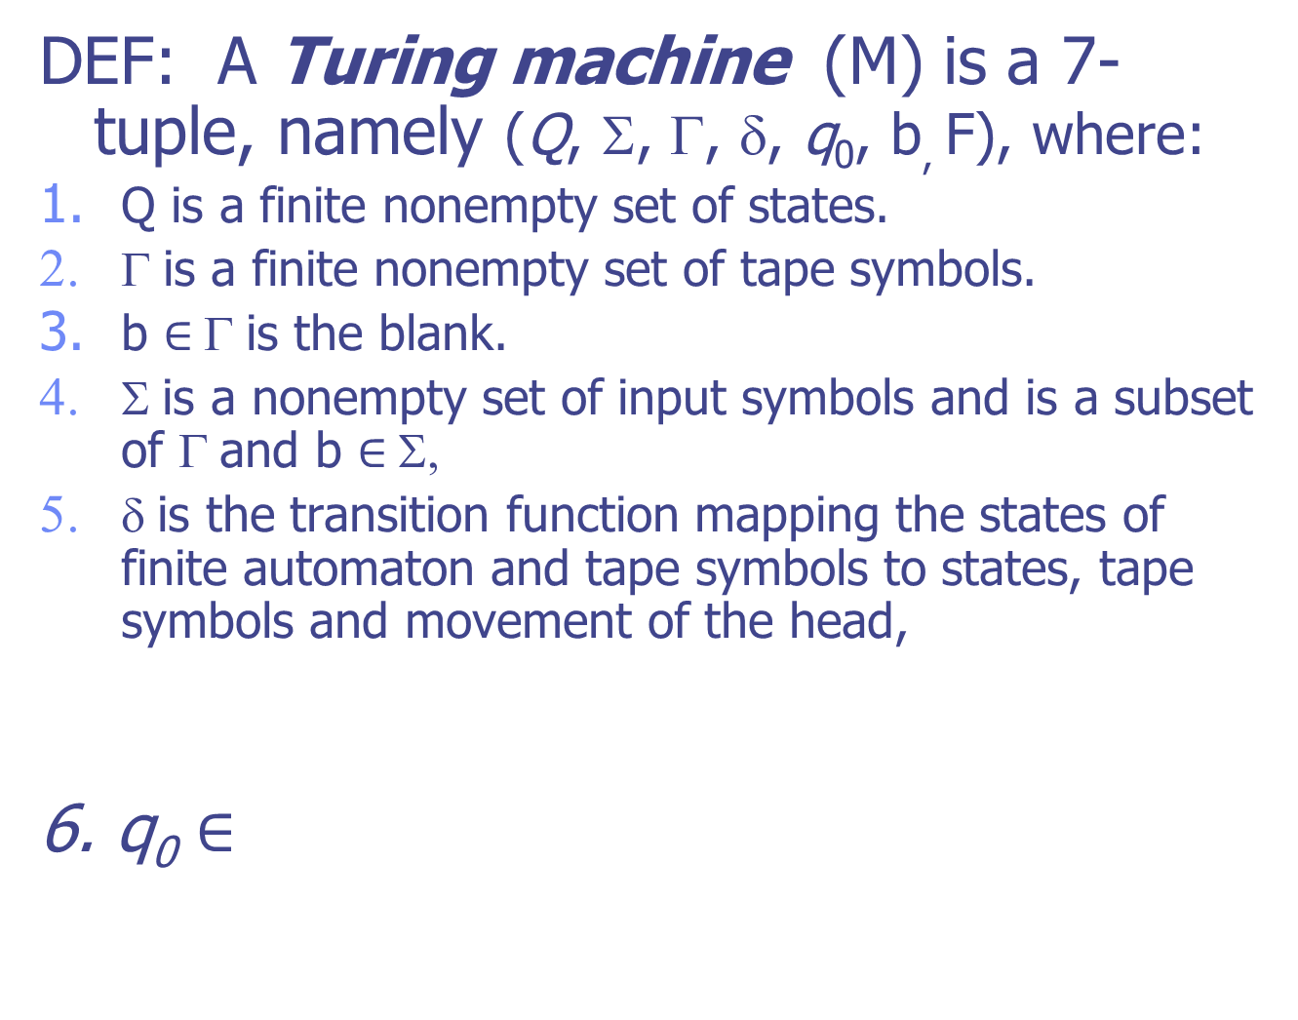

Slide 30
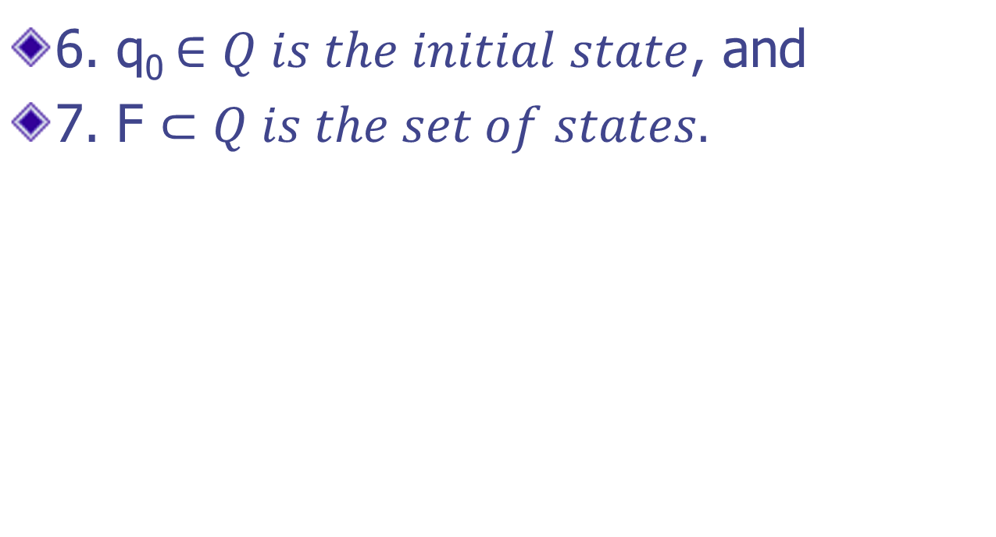

Slide 31
Representation of Turing Machine
We can describe a Turing Machine using:
Instantaneous Description
Transition Table,
Transition Diagram

Slide 32
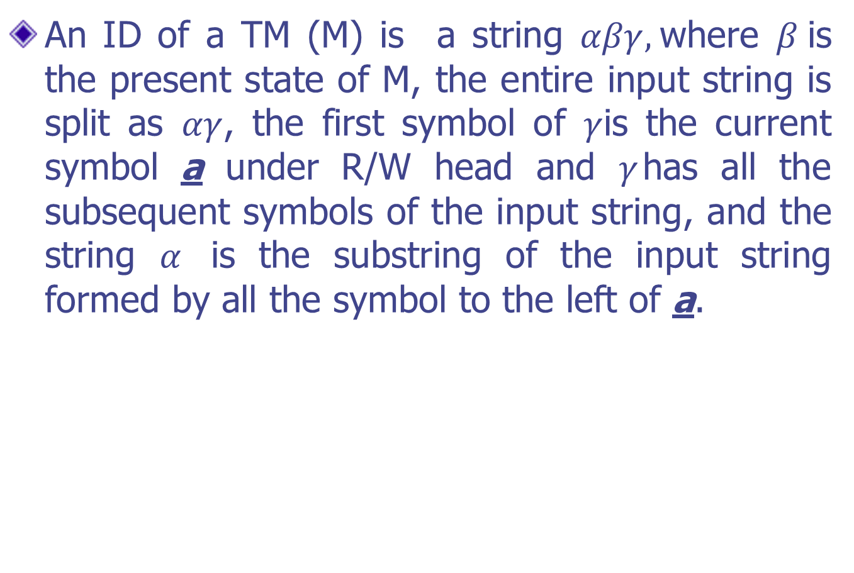
(i) Instantaneous Description

Slide 33
Q: A Snapshot of TM is as follows, obtain the ID?
Ans: The present symbol under R/W head is a₁. The present state is q_{3.} so a₁ is written to the right of q₃.
 | b | a4 | a1 | a2 | a1 | a2 | a2 | a1 | a4 | a2 | b
R/W Head
State q3

Slide 34
The string a₄a₁a₂a₁a₂a₂, which is written to the left of q₃ and the sequence of nonblank symbols to the right of a₁ is a₄a₂.
Thus the ID is as follows
a₄ a₁ a₂ a₁ a₂ a₂ q₃ a₁ a₄a₂
Present State
Symbol under R/W Head

Slide 35
Moves in a TM
δ(q , x) includes a change in ID of the turing machine. We call this change in ID a move.
suppose δ(q , x_{i}) = (p, y, L). The input string to be processed is x₁ x₂ …..x_{i} x_{n} and the present symbol under R/W head is x_{i} .
So the ID before processing x_{i} is x₁ x₂ x₃ x_{i-1} qx_{i} …x_{n} .
After processing of x_{i} , the resulting ID is
x₁ x₂ x₃ x_{i-2} px_{i-1} yx_{i+1} …x_{n} .

Slide 36
(ii)Movement by Transition Table
Present Symbol | Tape Symbol
 | b | 0 | 1
q₁ | 1Lq₂ | 0Rq₁
q₂ | bRq₃ | 0Lq₂ | 1Lq₂
q₃ |  | bRq₄ | bRq₅
q₄ | 0Rq₅ | 0Rq₄ | 1Rq₄
q₅ | 0Lq₂
q₅

Slide 37
Q: Consider the TM Description given in the above slide, Draw the computation sequence of the string 00.
00b----→ bbbbq₅0000

Slide 38
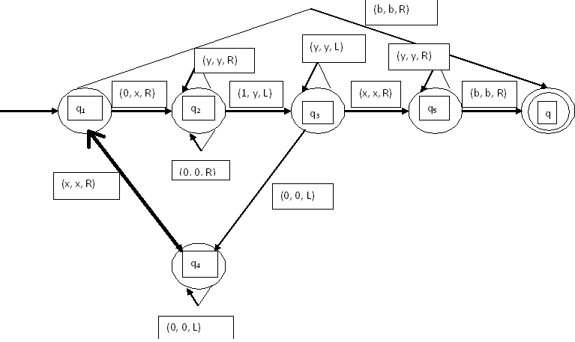
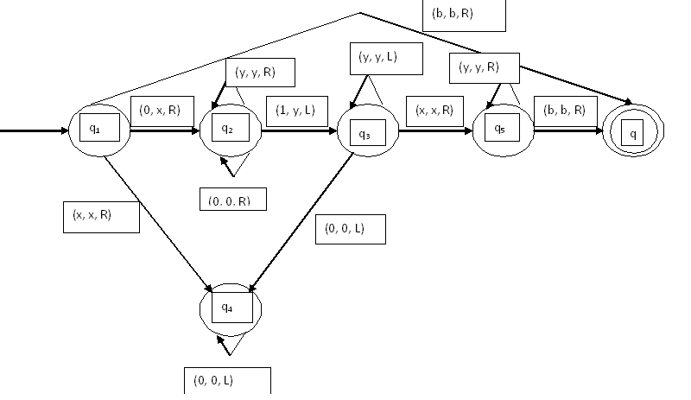
(iii) Representation by Transition Diagram

Slide 39
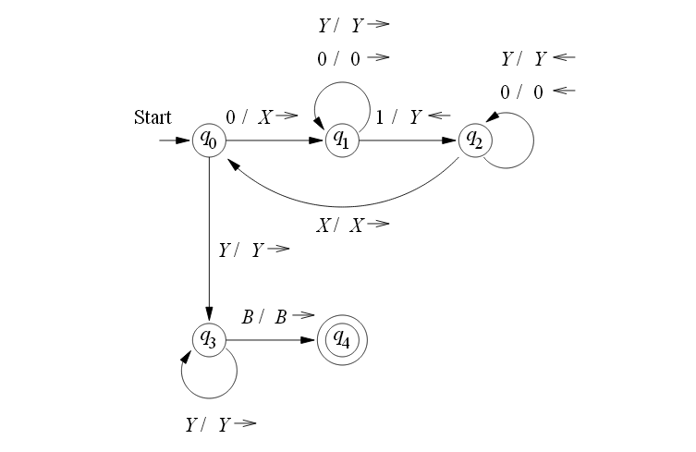

Slide 40
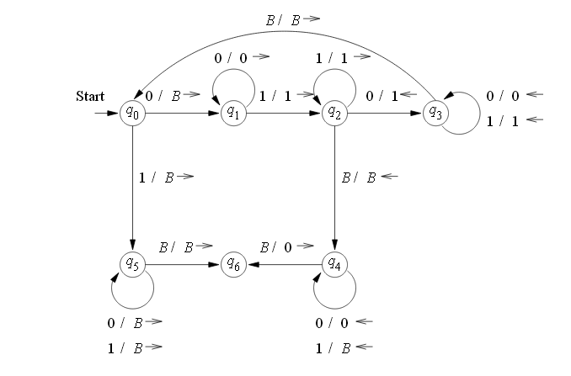

Slide 41
Q: M is a TM represented by the transition system in the above figure, obtain the computation sequence of M for processing the input string 0011.
Ans: b0011b---→bxxyybb

Slide 42
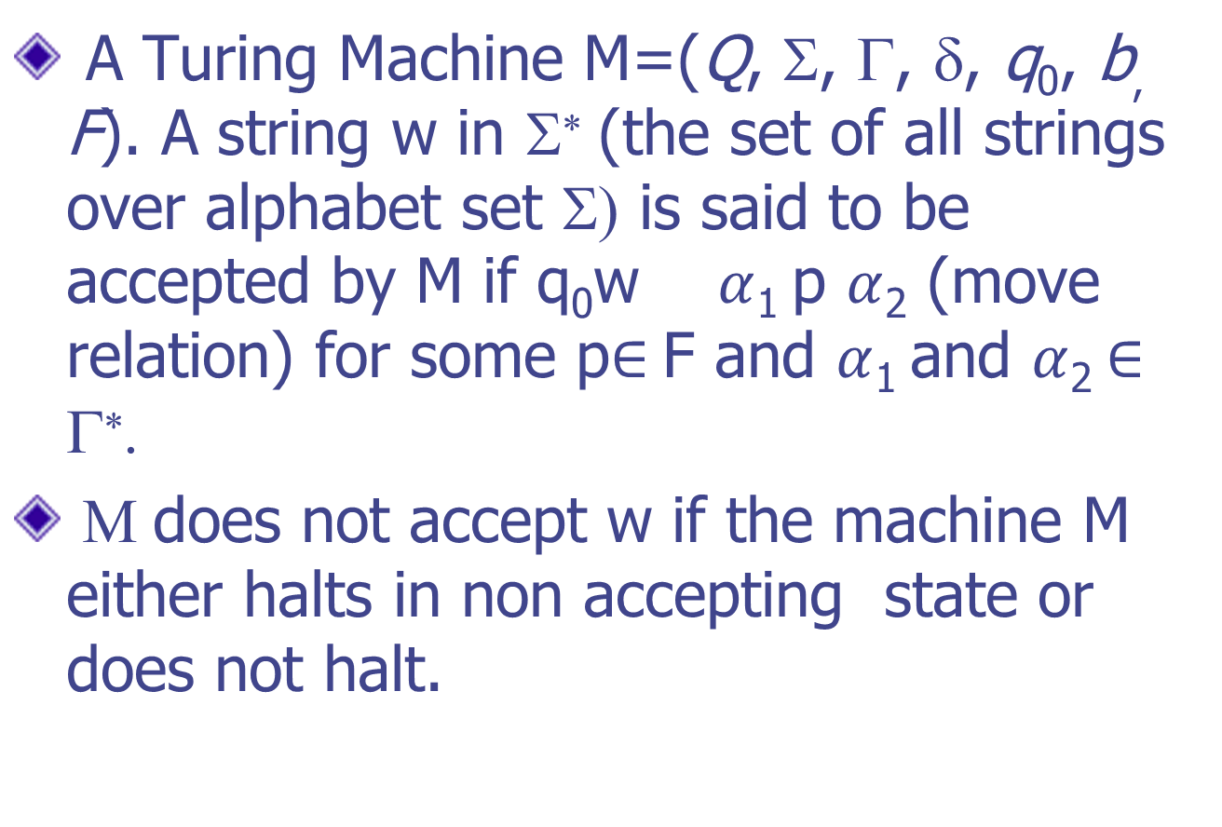
Language Acceptability by TM
A Turing Machine M=(Q, Σ, Γ, δ, q₀, b, F). A string w in Σ∗(the set of all strings over alphabet set Σ) is said to be accepted by M if q₀w $α$₁ p $α$₂ (move relation) for some p$∈$F and $α$₁ and $α$₂ $∈$Γ∗.
Μ does not accept w if the machine M either halts in non accepting state or does not halt.

Slide 43
Q: Consider the Turing Machine M described by the transition table as given below. Describe the processing of (a) 011 (b)0011 (c) 001 using ID’s. Which of the above strings are accepted by M?
Present State | Tape Symbol
 | 0 | 1 | x | y | b
q₁ | xRq₂ |  |  |  | bRq₅
q₂ | 0Rq₂ | yLq₃ |  | yRq₂
q₃ | 0Lq₄ |  | xRq₅ | yLq₃
q₄ | 0Lq₄ |  | xRq₁
q₅ |  |  |  | yRq₅ | bRq₆
q₆
q₆

Slide 44
Design of TM (Basic Guidelines)
The fundamental objective in scanning a symbol by R/W head is to “Know” what to do in the future. The machine must remember the past symbol scanned . The TM can remember this by going to the next unique state.
The number of state must be minimized. This can be achieved by changing the states only when there is a change in the written symbol or when there is a change in the movement of R/W head.

Slide 45
Design a TM to recognize all strings consisting of even number of 1’s.
Sol^{n}: The construction is made by defining the moves in the following manner:
q₁ is the initial state, M enters state q₂ on scanning 1 and writes b.
If M is in the state q₂ and scans 1, enters q₁ and writes b.
q₁ is the only accepting state.
M={ {q_{1,} q₂}, {1, b}, {1, b}, δ, q₁, b, {q₁}}
M=(Q, Σ, Γ, δ, q₀, b, F)

Slide 46
Where is defined as the following Transition table
Present State | 1
 | bq₂R
q₂ | bq₁R
q₁

Slide 47
Obtain the computation sequence of 11 (Accepting State)
111 (not accepting state)

Slide 48
Q: Design a TM over {1, b} which can compute concatenation function over Σ={1}, if a pair of words (w1, w2) is the input, the output has to be w1w2.
Input
Output
b | 1 | 1 | b | 1 | 1 | 1 | b
w1
w2
b | 1 | 1 | 1 | 1 | 1 | b | b
w1w2

Slide 49
Transition Table for concatenation of two string:
Present Status | Tape Symbol
 | 1 | b
q₀ | 1Rq₀ | 1Rq₁
q₁ | 1Rq₁ | bLq₂
q₂ | bLq₃ | -
q₃ | 1Lq₃ | bRq_{F}
 | - | -
q_{F}

Slide 50
Q: Design a TM to recognize the language {1^{n} 2^{n} 3^{n} | n≥ 1} 112233/1223
Transition Table for the above problem
Present State | Input Tape Symbol
 | 1 | 2 | 3 | b
q₁ | bRq₂ | - | - | bRq₁
q₂ | 1Rq₂ | bRq₃ | - | bRq₂
q₃ | - | 2Rq₃ | bRq₄ | bRq₃
q₄ | - | - | 3Lq₅ | bLq₇
q₅ | 1Lq₆ | 2Lq₅ | - | bLq₅
q₆ | 1Lq₆ |  |  | bRq₁
q₇

Slide 51
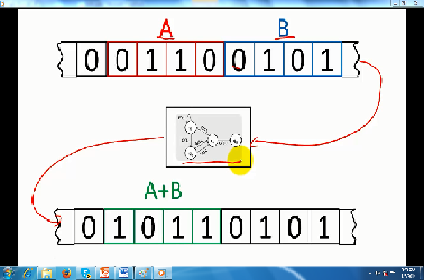
Universal Turing Machine
The Turing Machine that were considered for the design in the earlier examples are special-purpose computers.

Slide 52
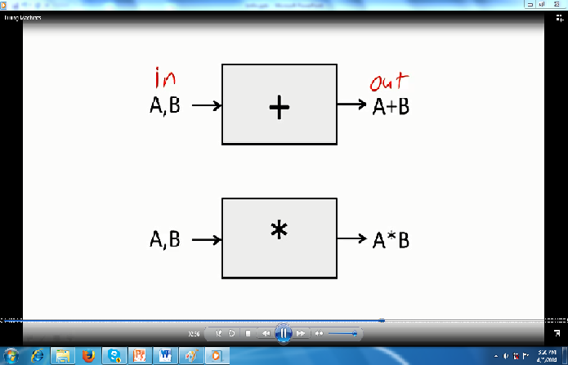

Slide 53
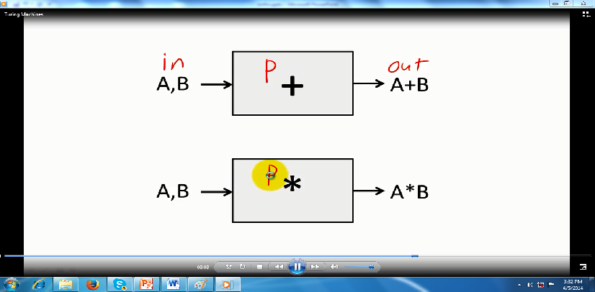

Slide 54
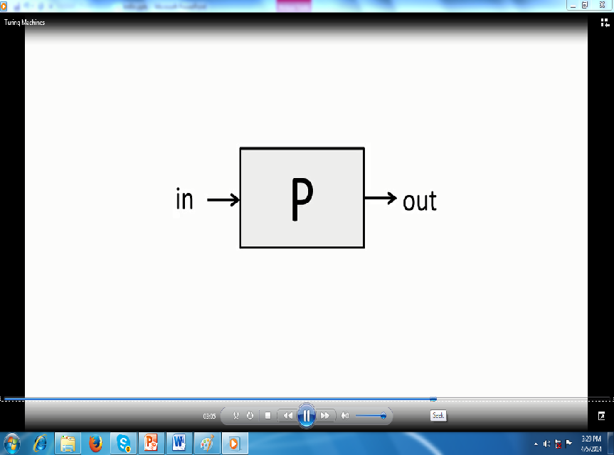

Slide 55
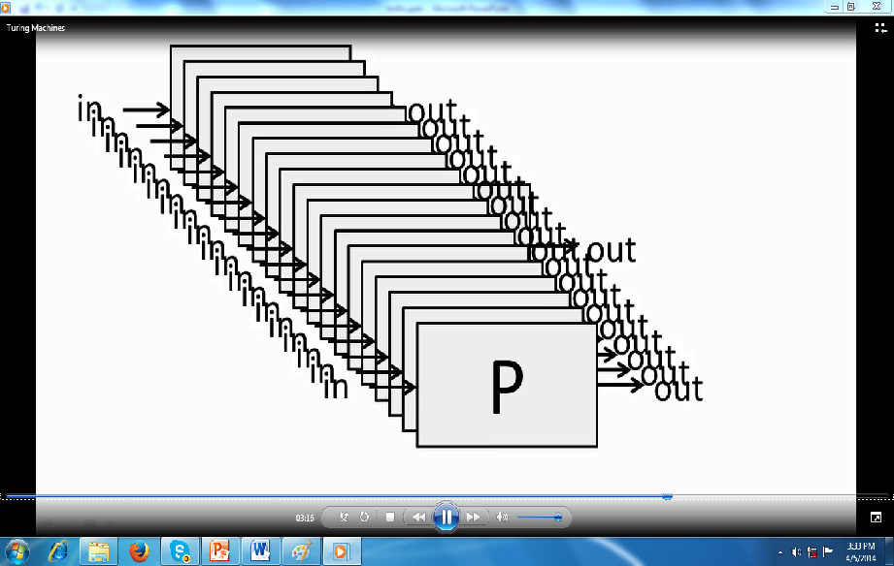

Slide 56
We must design a machine that can accept two inputs:
The input data, And
A description of Computation (Algorithm/Program)
(This is precisely what a general-purpose computer does, It accepts data and a program)
A general-purpose TM is usually called Universal Turing Machine, which is powerful enough to simulate the behavior of any computer, including any Turing Machine itself.

Slide 57
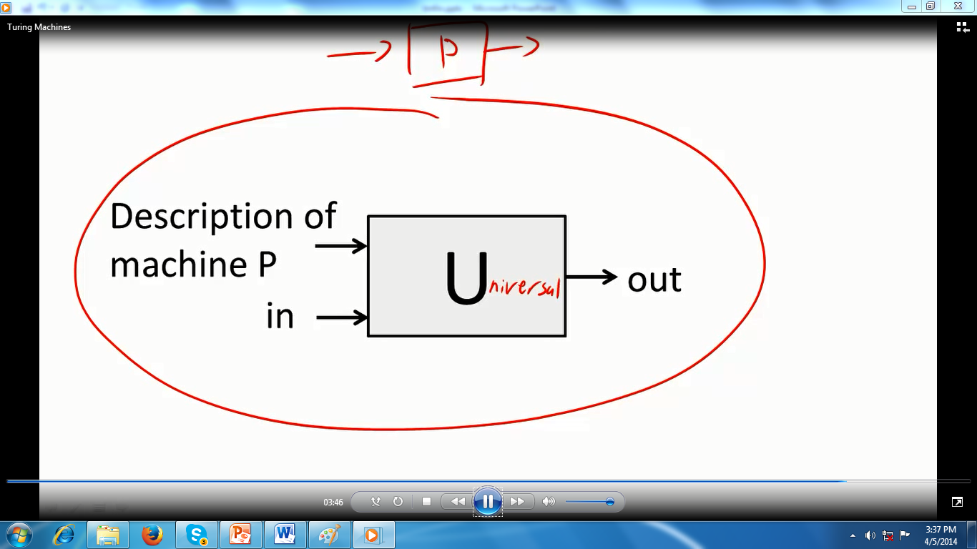
(Data)

Slide 58
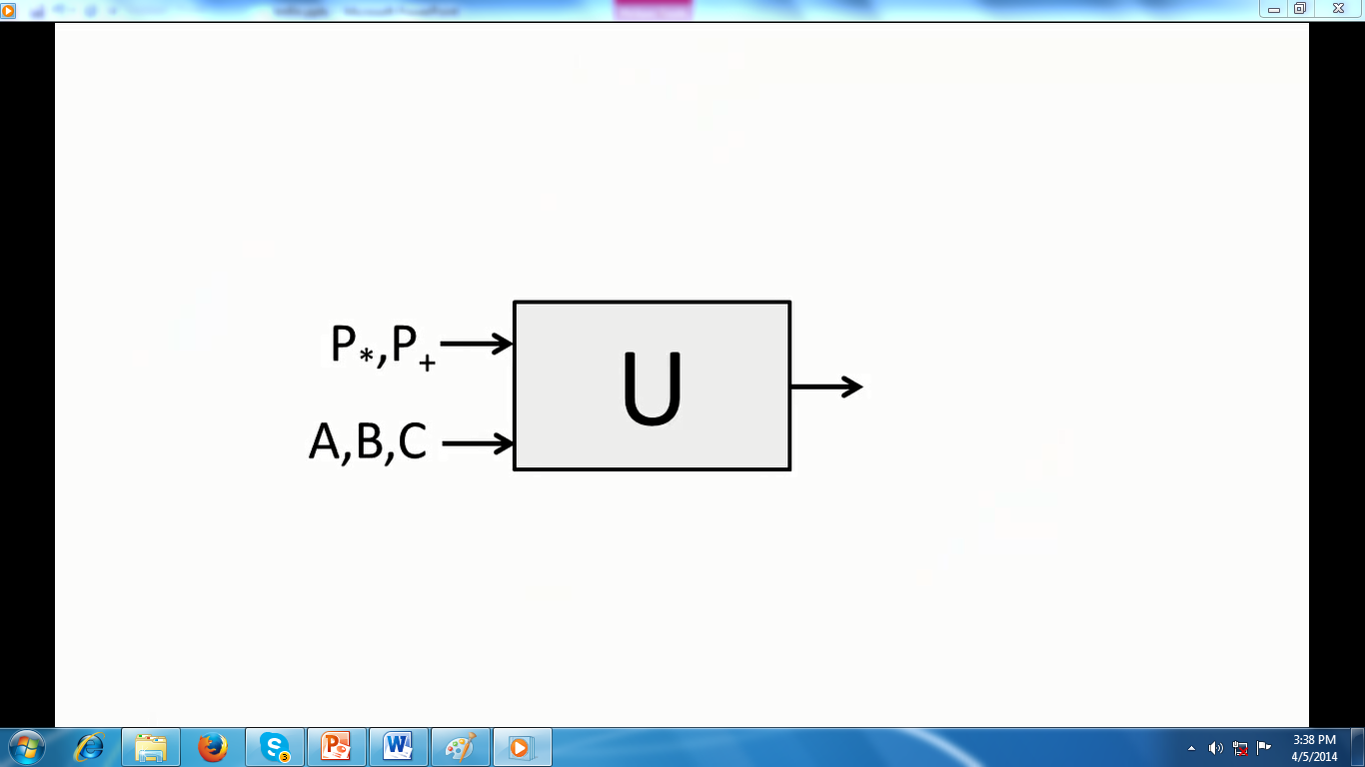

Slide 59
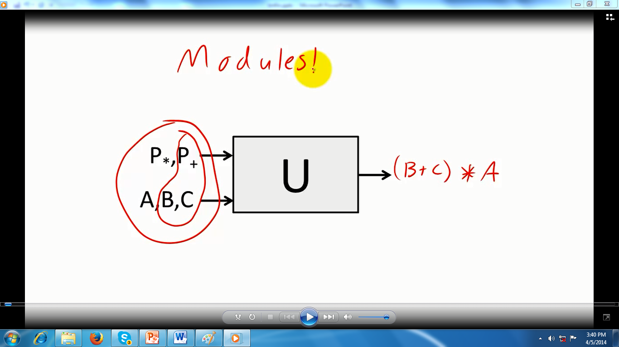

Slide 60
Halting Problem
Almost every program written in a programming language involves some form of repetition—loops or recursive functions. A repetition construct may never terminate (halt): that is, a program can run forever if it has an infinite loop. For example, the following program in Simple Language never terminates:
int x=1;
While (x)
{
}

Slide 61
Halting Problem
An important question of computing science is “Are there problems that cannot be solved?”
There are, and probably the most famous of these is the halting problem described by Turing.
He was thinking in terms of Turing machines (there were no computers), but it is easy to extend the idea

Slide 62
Halting Problem
Halting problem
Can we write a program that will look at any computer program and its input and decide if the program will halt (not run infinitely)?
A practical solution might be to run the program and if it halts you have your answer. If after a given amount of time it doesn’t halt, guess that it won’t halt. However, you wouldn’t know if the program would eventually halt.

Slide 63
Halting Problem
As it turns out the problem is undecidable.
For a problem to be undecidable you just have to prove that there is one case it can’t produce an answer for.
The case that Turing came up with that can never be solved involves giving a program itself as input.

Slide 64
Can we write a program that tests whether or not any program, represented by its integer number, will terminate?
The existence of this program would save programmers a lot of time. Running a program without knowing if it halts or not is a tedious job. Unfortunately, it has now been proven that such a program cannot exist—much to the disappointment of programmers!

Slide 65
Halting Problem
Let’s assume we’re given a function halts(prog,input) that is supposed to tell us if the program prog will halt if given the input. The function will return True if it halts, False otherwise.

Slide 66
The halting problem is not solvable
Instead of saying that the testing program does not exist and can never exist, the computer scientist says “The halting problem is not solvable”.
Proof
Let us give an informal proof about the nonexistence of this testing program. Our method, called proof by contradiction, is often used in mathematics: we assume that the program does exist, then show that its existence creates a contradiction—therefore, it cannot exist. We use three steps to show the proof in this approach.

Slide 67
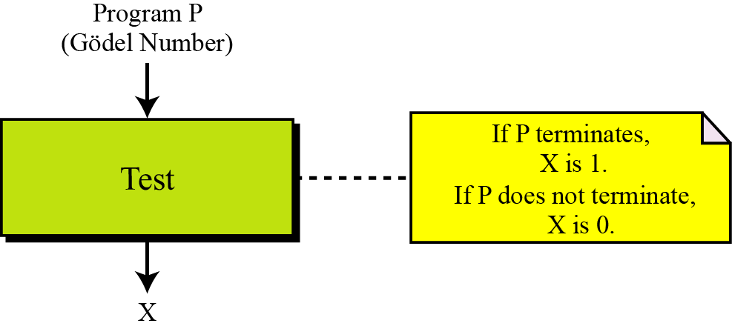
Step 1
In this step, we assume that a program, called Test, exists. It can accept any program such as P, represented by its Gödel number(integer number), as input, and outputs either 1 or 0. If P terminates, the output of Test is 1: if P does not terminate, the output of
Test is 0 (Figure 17.14).
Step 1 in the proof

Slide 68
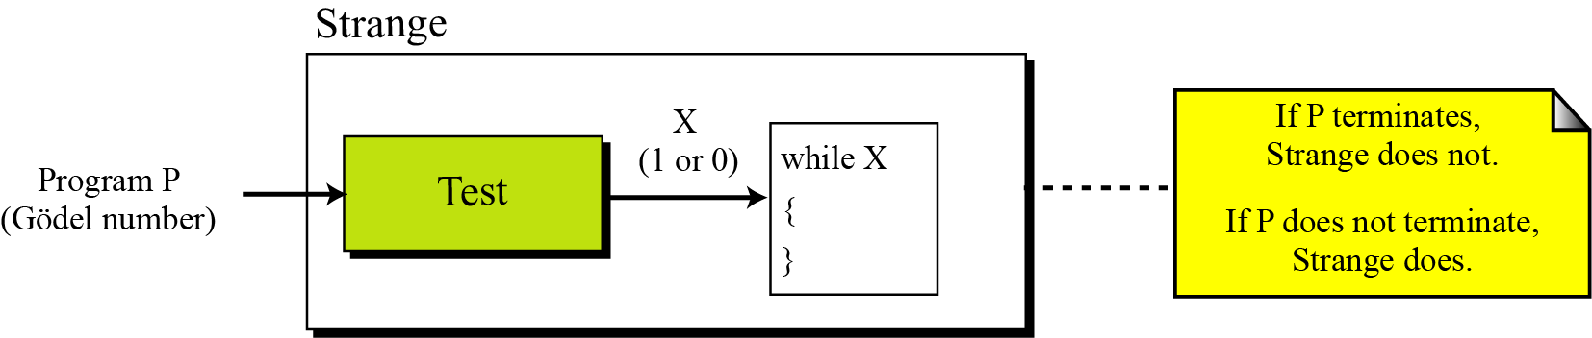
Step 2
In this step, we create another program called Strange that is made of two parts: a copy of Test at the beginning and an empty loop—a loop with an empty body—at the end. The loop uses X as the testing variable, which is actually the output of the Test program. This program also uses P as the input.
Step 2 in the proof

Slide 69
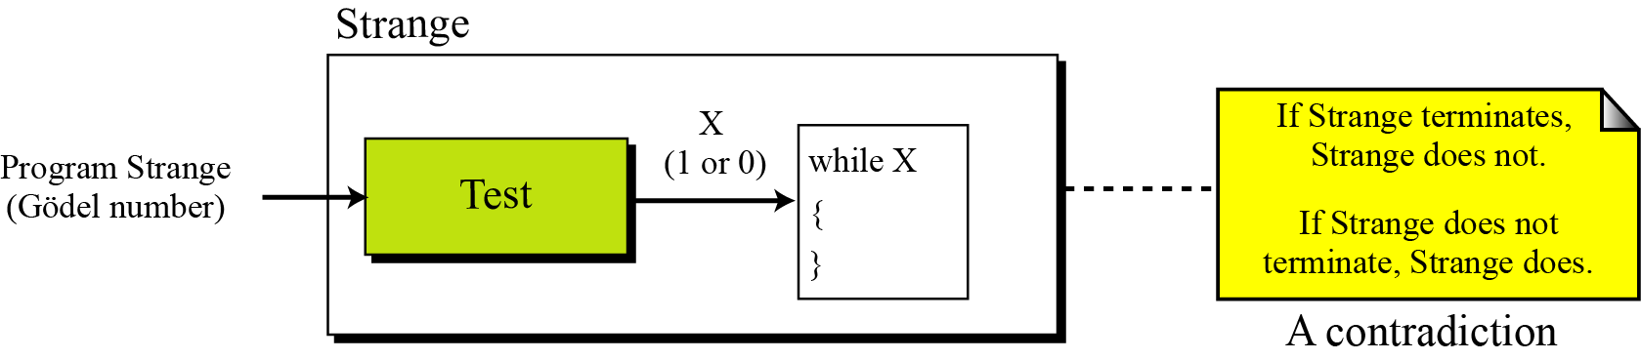
Step 3
Having written the program Strange, we test it with itself (its Gödel number) as input. This is legitimate because we did not put any restrictions on P. Figure 17.16 shows the situation.
Step 3 in the proof

Slide 70
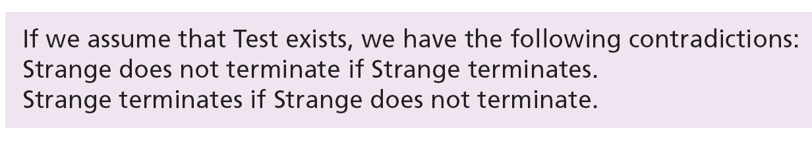

Contradiction
This proves that the Test program cannot exist and that we should stop looking for it, so…
i
The halting problem is unsolvable.
The un-solvability of the halting program has proved that many other programs are also unsolvable, because if they are solvable, then the halting problem is solvable—which it is not.

Slide 71
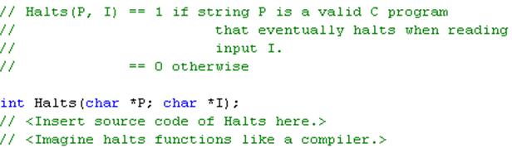

The Halting Problem is not possible in C/C++ .
Assume a Halts() function exists. Input the c program from earlier into the function.
Imagine the function Halts(program, input).
If Halts exists it is guaranteed to return.

Slide 72

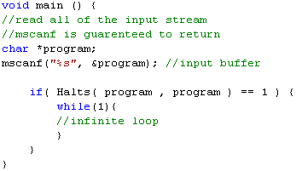
The Halting Problem is not possible in C/C++.
Observe the new program in C. Save the program as diagonal.c
Run diagonal and add its own source code as input.
Halts(diagonal, diagonal)
results in two cases.
Returns 0, then diagonal
loops forever, but this can only
happen if Halts returns 1.
Returns 1, then diagonal
halts, but this can only happen
if Halts returns 0.
This contradiction means the
Halts() function cannot exist.

Slide 73
Halting Problem Re-visted
A Few Thing Computer can do really well
Let us suppose, The computer “A” is a very good computing device developed for “Arithmetic”, it always perform well, when we input numbers and operation to perform, like {5+4=9, 6*4=24}

Slide 74
Let us assume there is another computer “ C”, which plays checkers (Chess) very well and it is designed to play checkers, it takes checkers as input and gives next move as output.
We have developed such type of general purpose computes today.
Now, can we input numbers to machine “C” or even can we input checkers to machine “A”
The answer is NOOOO!!!!, it will create Halting Problem.

Slide 75
Can we create a machine “H” of hybrid nature, which may receive the blue-print of machine “A” and number as input to perform arithmetic's And which receive blue-print of machine “C” and checker as input to decide the next move.
What if we give blue-print of “A” and input of checkers or vice-versa.
No such machine exits and Halting Problem is not solvable.

